Slide 1


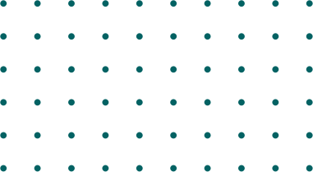
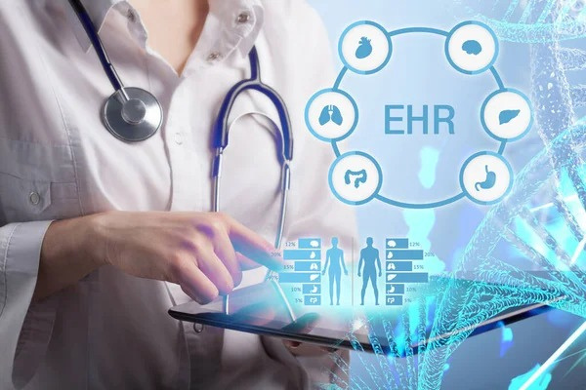
AI-Powered-Enhanced EHR Imaging & Documentation System
Milestone: 1
Data Collection and Preprocessing
Team Name: TEAM-B
Mentor name: Aryan Khurana
Team Members: Pushpa Latha
Nikshitha Naradasu
Shaik Afreen Hasen
Saniha Manjunath
Gaurav Subhash Borse
Tejasri Nakka
DEEPANA
Pranjali Jadhav
Vignesh M J

Slide 2

OBJECTIVE
To systematically gather, preprocess, and standardize medical imaging and EHR data, ensuring readiness for AI model training.
Focus on acquiring diverse datasets, including MRI, CT, and X-ray images, to enhance the robustness of our AI models.
Data Collection
Primary Goal
Collect and clean both structured and unstructured EHR data, ensuring high-quality input for AI applications.
Develop a comprehensive, labeled dataset that integrates imaging and EHR data, primed for Generative AI model training.
Unified Dataset Creation
EHR Data Management
Presentation I 05

Slide 3
PROBLEM STATEMENT
The current healthcare workflow involves time-consuming analysis, manual interpretation of medical data, and repetitive documentation tasks. This leads to delays and human errors. There is a growing need for automation to streamline clinical processes and improve efficiency in diagnosis and reporting.
Presentation I 01

Slide 4
PROPOSED SOLUTION / ARCHITECTURE OVERVIEW
AI-Driven EHR System
An innovative system that integrates medical imaging with clinical data, powered by Azure OpenAI services.
Architecture Modules
Key components include data collection and preprocessing, medical imaging enhancement, clinical note automation, and system integration.
The architecture is designed for smooth deployment and integration into existing healthcare workflows.
Seamless Integration
Presentation I 02

Slide 5
TOOLS & TECHNOLOGIES USED
Python:
The primary programming language utilized for developing the AI models and data processing scripts
Pandas & NumPy:
Essential libraries for data cleaning, manipulation, and analysis, enabling efficient handling of large datasets.
PIL (Pillow):
A powerful library for image preprocessing and resizing, crucial for preparing medical images for analysis.
Google Collab:
A cloud-based environment that facilitates collaborative coding and execution of our AI models.
GitHub:
A version control platform that supports collaboration and tracking of project progress.
Presentation I 04

Slide 6
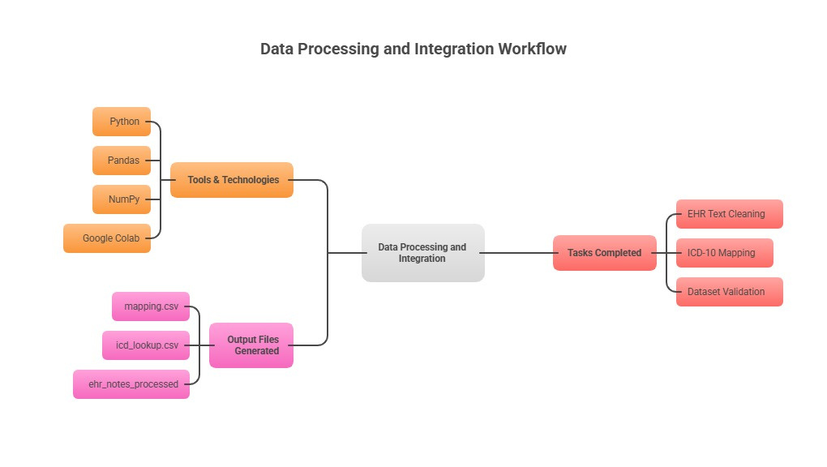
IMPLEMENTATION PROGRESS
Presentation I 07

Slide 7
CHALLENGES FACED
Normal Class Mismatch
The EHR dataset initially lacked a 'No Tumor' category, leading to incomplete mapping of MRI images.
Inconsistent Filenames
MRI image filenames had varying prefixes, complicating the extraction of correct class information.
Presentation I 03

Slide 8
LEARNINGS & SOLUTIONS
Normal Class Mismatch Resolution
We learned that real-world datasets often contain inconsistencies; we added a 'No Tumor' class to ensure dataset balance.
Filename Prefix Automation
Recognizing the unreliability of filename-based classification, we developed an automated validation script to cross-check with EHR biopsy results.
Presentation I 06

Slide 9
NEXT STEPS
In the next phase, we’ll apply GenAI models for denoising and enhancing medical images to improve diagnostic quality. The focus will be on training and fine-tuning image enhancement models using Azure OpenAI tools for clearer, more realistic visualizations.
Presentation I 08

Slide 10
THANK YOU
Presentation I 09

